Slide 1

Principles of Information Security
Chapter 5
Risk Management
Copyright © 2018 Cengage. May not be copied, scanned, or duplicated, in whole or in part, except for use as permitted in a license distributed with a certain product or service or otherwise on a password-protected website for classroom use.

Slide 2
Learning Objectives
Upon completion of this material, you should be able to:
Define risk management, risk identification, risk assessment, and risk control
Describe how risk is identified and assessed
Assess risk based on probability of occurrence and likely expected impact
Explain the fundamental aspects of documenting risk via the process of risk assessment
Describe various options for a risk mitigation strategy
Define risk appetite and explain how it relates to residual risk
Discuss conceptual frameworks for evaluating risk controls and formulate a cost-benefit analysis
Notes:
Learning Objectives
Upon completion of this chapter you should be able to:
Define risk management, risk identification, and risk control
Describe how risk is identified and assessed
Assess risk based on probability of occurrence and likely impact
Explain the fundamental aspects of documenting risk via the process of risk assessment

Slide 3
Introduction (1 of 2)
Organizations must design and create safe environments in which business processes and procedures can function.
Risk assessment: A determination of the extent to which an organization’s information assets are exposed to risk.
Risk control: The application of controls that reduce the risks to an organization’s information assets to an acceptable level.
Notes:
Introduction
Organizations must design and create safe environments in which business processes and procedures can function
Risk management: process of identifying, assessing, and reducing risks facing an organization
Risk identification: enumeration and documentation of risks to organization’s information assets
Risk control: application of controls that reduce risks to an organization’s assets to an acceptable level

Slide 4
Introduction (2 of 2)
Risk identification: The recognition, enumeration, and documentation of risks to an organization’s information assets.
Risk management: The process of identifying risk, assessing its relative magnitude, and taking steps to reduce it to an acceptable level.
Notes:
Introduction
Organizations must design and create safe environments in which business processes and procedures can function
Risk management: process of identifying, assessing, and reducing risks facing an organization
Risk identification: enumeration and documentation of risks to organization’s information assets
Risk control: application of controls that reduce risks to an organization’s assets to an acceptable level

Slide 5
An Overview of Risk Management
Know yourself: identify, examine, and understand the information and systems currently in place
Know the enemy: identify, examine, and understand the threats facing the organization
Responsibility of each community of interest within an organization to manage the risks that are encountered
Notes:
Know Ourselves
Know yourself: identify, examine, and understand the information and systems currently in place
Know the enemy: identify, examine, and understand threats facing the organization
Responsibility of each community of interest within an organization to manage risks that are encountered

Slide 6
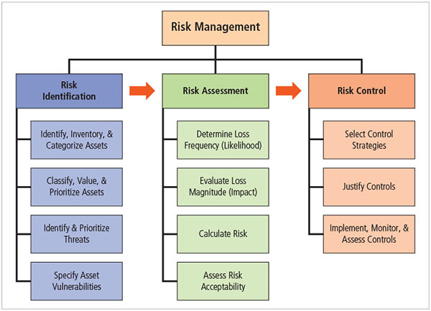
Figure 5-1 Components of risk management

Slide 7
The Roles of the Communities of Interest
Information security, management and users, and information technology all must work together.
Communities of interest are responsible for:
Evaluating current and proposed risk controls
Determining which control options are cost effective for the organization
Acquiring or installing the needed controls
Ensuring that the controls remain effective
Notes:
Roles of Communities of Interest
Information security, management and users, and information technology all must work together
Communities of interest are responsible for:
Evaluating the risk controls
Determining which control options are cost effective for the organization
Acquiring or installing the needed controls
Ensuring that the controls remain effective

Slide 8
Risk Appetite and Residual Risk
Risk appetite: The quantity and nature of risk that organizations are willing to accept as they evaluate the trade-offs between perfect security and unlimited accessibility.
Reasoned approach is one that balances the expense of controlling vulnerabilities against possible losses if the vulnerabilities are exploited.
Residual risk: The risk to information assets that remains even after current controls have been applied.
The goal of information security is to bring residual risk into line with risk appetite.

Slide 9
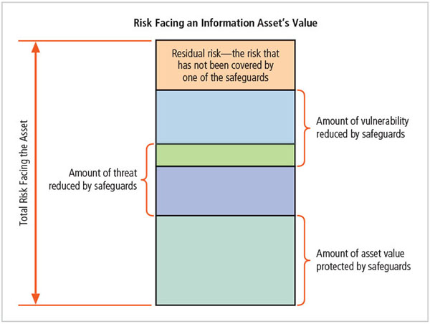
Figure 5-3 Residual risk

Slide 10
Risk Identification
Risk management requires that InfoSec professionals know how to identify, classify, and prioritize an organization’s information assets.
A threat assessment process identifies and evaluates the risks facing each asset
Notes:
Risk Identification
Risk management involves identifying, classifying, and prioritizing an organization’s assets
A threat assessment process identifies and quantifies the risks facing each asset

Slide 11
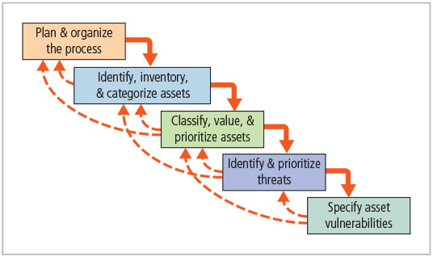
Figure 5-4 Components of risk identification

Slide 12
Planning and Organizing the Process
The first step in the risk identification process is to follow your project management principles.
Begin by organizing a team with representation across all affected groups.
The process must then be planned out.
Periodic deliverables
Reviews
Presentations to management
Tasks should be laid out, assignments made, and timetables discussed.
Notes:
Plan/Organize the Process
First step in the Risk Identification process is to follow your project management principles
Begin by organizing a team with representation across all affected groups
The process must then be planned out
Periodic deliverables
Reviews
Presentations to management
Tasks laid out, assignments made and timetables discussed

Slide 13
Identifying, Inventorying, and Categorizing Assets
Iterative process: Begins with the identification and inventory of assets, including all elements of an organization’s system (people, procedures, data and information, software, hardware, networking)‏
Assets are then categorized
Notes:
Asset Identification and Valuation
This iterative process begins with the identification of assets, including all of the elements of an organization’s system: people, procedures, data and information, software, hardware, and networking elements.
Then, we classify and categorize the assets adding details as we dig deeper into the analysis.

Slide 14
Table 5-1 categorization the components of an information system
Traditional system components | Information asset components | Risk management system components
People | Nonemployees | Trusted employees other staff
 | Procedures | People at trusted organizations strangers and visitors
Procedures | Information | IT and business standard IT and business-sensitive procedures
Data | Software | Transmission Processing Storage
Software | System devices and peripherals | Application Operating system Security components
Hardware | System devices and peripherals | System and peripherals Security devices
 | Networking components | Intranet components Internet or DMZ components

Slide 15
People, Procedures, and Data Asset Identification
Human resources, documentation, and data information assets are more difficult to identify.
Important asset attributes:
People: position name/number/ID; supervisor; security clearance level; special skills
Procedures: description; intended purpose; relation to software/hardware/networking elements; storage location for reference; storage location for update
Data: classification; owner/creator/manager; data structure size; data structure used; online/offline; location; backup procedures employed
Notes:
People, Procedures, and Data Asset Identification
Human resources, documentation, and data information assets are more difficult to identify
Important asset attributes:
People: position name/number/ID; supervisor; security clearance level; special skills
Procedures: description; intended purpose; relation to software/hardware/networking elements; storage location for reference; storage location for update
Data: classification; owner/creator/manager; data structure size; data structure used; online/offline; location; backup procedures employed

Slide 16
Hardware, Software, and Network Asset Identification
What information attributes to track depends on:
Needs of organization/risk management efforts
Preferences/needs of the security and information technology communities
Asset attributes to be considered are name, IP address, MAC address, element type, serial number, manufacturer name, model/part number, software version, physical or logical location, and controlling entity.
Notes:
Hardware, Software, and Network Asset Identification
Automated tools can sometimes uncover the system elements that make up the hardware, software, and network components.
Once created and stored, the inventory listing must be kept current, often through a tool that periodically refreshes the data.

Slide 17
Information Asset Inventory
Unless information assets are identified and inventoried, they cannot be effectively protected.
Inventory process involves formalizing the identification process in some form of organizational tool.
Automated tools can sometimes identify the system elements that make up hardware, software, and network components.
Notes:
Asset Inventory
Unless information assets are identified and inventoried, cannot be effectively protected
Inventory process involves formalizing identification process in some form of organizational tool
Automated tools can sometimes identify system elements that make up hardware, software, and network components

Slide 18
Asset Categorization
People comprise employees and nonemployees.
Procedures either do not expose knowledge useful to a potential attacker or are sensitive and could allow adversary to gain advantage.
Data components account for the management of information in transmission, processing, and storage.
Software components are applications, operating systems, or security components.
Hardware: either the usual system devices and peripherals or part of information security control systems.
Notes:
Asset Categorization
People comprise employees and nonemployees
Procedures either do not expose knowledge useful to a potential attacker, or are sensitive and could allow adversary to gain advantage
Data components account for management of information in transmission, processing, and storage
Software components are applications, operating systems, or security components
Hardware either usual system devices and peripherals, or part of information security control systems

Slide 19
Classifying, Valuing, and Prioritizing Information Assets
Many organizations have data classification schemes (e.g., confidential, internal, public data)‏.
Classification of components must be specific enough to enable the determination of priority levels.
Categories must be comprehensive and mutually exclusive.
Notes:
Information Asset Classification
Many organizations have data classification schemes (e.g., confidential, internal, public data)‏
Classification of components must be specific enough to enable determination of priority levels
Categories must be comprehensive and mutually exclusive

Slide 20
Data Classification and Management (1 of 2)
Variety of classification schemes are used by corporate and military organizations.
Information owners are responsible for classifying their information assets.
Information classifications must be reviewed periodically.
Classifications include confidential, internal, and external.
Notes:
Data Classification and Management
A variety of classification schemes are used by corporate and military organizations.
Information owners are responsible for classifying the information assets for which they are responsible.
At least once a year, information owners must review information classifications to ensure the information is still classified correctly and the appropriate access controls are in place.
The U.S. Military Classification Scheme has a more complex categorization system than required by most corporations. For most information, the military uses a five-level classification scheme: Unclassified, Sensitive But Unclassified (i.e., For Official Use Only), Confidential, Secret, and Top Secret.
Most organizations do not need the detailed level of classification used by the military or federal agencies. A simple scheme will allow the organization to protect its sensitive information, such as: Public, For official use only, Sensitive, Classified.

Slide 21
Data Classification and Management (2 of 2)
Security clearances
Each data user must be assigned authorization level indicating classification level.
Before accessing specific set of data, the employee must meet the need-to-know requirement.
Management of classified data includes storage, distribution, transportation, and destruction.
Clean desk policy
Dumpster diving
Notes:
Security Clearances
Security clearances
Each data user assigned authorization level indicating classification level
Before accessing specific set of data, employee must meet need-to-know requirement
Management of Classified Data includes storage, distribution, transportation, and destruction
Clean desk policy
Dumpster diving

Slide 22
Information Asset Valuation (1 of 2)
Questions help develop criteria for asset valuation.
Which information asset:
Is most critical to the organization’s success?
Generates the most revenue/profitability?
Plays the biggest role in generating revenue or delivering services?
Would be the most expensive to replace or protect?
Would be the most embarrassing or cause greatest liability if revealed?
Notes:
Information Asset Valuation
Questions help develop criteria for asset valuation
Which information asset:
Is most critical to organization’s success?
Generates the most revenue/profitability?
Plays biggest role in generating revenue or delivering services?
Would be most expensive to replace or protect?
Would be the most embarrassing or cause greatest liability if revealed?

Slide 23
Figure 5-7 Sample inventory worksheet (1 of 2)
System name: SLSE-Commerce
Date Evaluated: February 2012
Evaluated by: D.Jones
Information assets | Data classification | Impact to profitability
Information transmitted :
EDI document set 1-logistics BOL to outsourcers (outbound) | confidential | High
EDI document set 2-supplier orders (outbound) | confidential | High
EDI document set 3-supplier fulfillment advice (inbound) | confidential | Medium
Customer order via SSL (inbound) | confidential | Critical
Customer service request via e-mail (inbound) | Private | Medium

Slide 24
Figure 5-7 Sample inventory worksheet (2 of 2)
DMZ Assets:
Edge router | Public | Critical
Web server # 1-home page and core site | Public | Critical
Web server # 2-Application server | Public | Critical
Notes: BOL: Bill of lading
DMZ: Demilitarized zone
EDI:Electronic data interchange
SSL: secure sockets later

Slide 25
Information Asset Valuation (2 of 2)
Information asset prioritization
Create weighting for each category based on the answers to questions.
Prioritize each asset using weighted factor analysis.
List the assets in order of importance using a weighted factor analysis worksheet.
Notes:
Information Asset Valuation (cont’d.)
Information asset prioritization
Create weighting for each category based on the answers to questions
Prioritize each asset using weighted factor analysis
List the assets in order of importance using a weighted factor analysis worksheet

Slide 26
Table 5-2 Example of a weighted factor analysis worksheet
Information Asset | Criterion 1: Impact to Revenue | Criterion 2: Impact to Profitability | Criterion 3: Impact to public image | Weighted score
Criteria weights must total 100 | 30 | 40 | 30
EDI document set 1-logistics BOL to outsourcer (outbound) | 0.8 | 0.9 | 0.5 | 75
EDI document set 2-Supplier orders (outbound) | 0.8 | 0.9 | 0.6 | 78
EDI document set 2-Supplier Fulfillment advice (inbound) | 0.4 | 0.5 | 0.3 | 41
Customer order via SSL (inbound) | 1.0 | 1.0 | 1.0 | 100
Customer service request via e-mail (inbound) | 0.4 | 0.4 | 0.9 | 55
Note: In the table, EDI stands for electronic data interchange, BOL stands for bill of lading, and SSL is secure sockets layer,

Slide 27
Identifying and Prioritizing Threats
Realistic threats need investigation; unimportant threats are set aside.
Threat assessment:
Which threats present a danger to assets in the given environment?
Which threats represent the most danger to information?
How much would it cost to recover from a successful attack?
Which threats would require greatest expenditure to prevent?
Notes:
Threat Identification
Each of these threats identified has the potential to attack any of the assets protected.
If we assume every threat can and will attack every information asset, this will quickly become more complex and overwhelm the ability to plan.
To make this part of the process manageable, each step in the threat identification and vulnerability identification process is managed separately and then coordinated at the end of the process.

Slide 28
Table 5-3 Threats to information security (1 of 2)
Threat | Examples
Compromises to intellectual property | Software piracy or other copyright infringement
Deviation in quality of service from service provides | Fluctuations in power, data, and other services
Espionage or trespass | Unauthorized access and/or data collection
Forces of nature | Fire, food, earthquake, lightning, etc.
Human error of failure | Accidents, employee mistakes, failure to follow policy
Information extortion | Blackmail threat of information disclosure
Sabotage or vandalism | Damage to or destruction of system or information
Software attacks | Malware: viruses, worms, macros, denial of services, or script injections

Slide 29
Table 5-3 Threats to information security (2 of 2)
Threat | Examples
Technical hardware failures or errors | Hardware equipment failure
Technical software failures or errors | Bugs, cool problems, loopholes, back doors
Technological obsolescence | Antiquated or outdated technologies
Theft | Illegal confiscation of equipment or information
Source: communications of the ACM, used with permission.

Slide 30
Specifying Asset Vulnerabilities
Specific avenues that threat agents can exploit to attack an information asset are called vulnerabilities.
Examine how each threat could be perpetrated and list the organization’s assets and vulnerabilities.
Process works best when people with diverse backgrounds within organization work iteratively in a series of brainstorming sessions.
At the end of the risk identification process, prioritized list of assets with their vulnerabilities is achieved.
Can be combined with weighted list of threats to form threats-vulnerabilities-assets (TVA) worksheet
Notes:
Vulnerability Identification
Specific avenues threat agents can exploit to attack an information asset are called vulnerabilities
Examine how each threat could be perpetrated and list organization’s assets and vulnerabilities
Process works best when people with diverse backgrounds within organization work iteratively in a series of brainstorming sessions
At end of risk identification process, prioritized list of assets with their vulnerabilities is achieved

Slide 31
Table 5-7 vulnerability assessment of a hypothetical DMZ router (1 of 2)
Threat | Possible vulnerabilities
Compromises to intellectual property | Copyrighted works developed in-house and stored on intranet servers can be copied without permission unless the router is configured to limit access from outsiders. Works copyrighted by others can be stolen: your organization is liable for that loss to the copyright holder.
Espionage or trespass | This information asset (router) may have little intrinsic value, but other assets protected by this device could be attacked if it does not perform correctly or is compromised.
Forces of nature | All information assets in the organization are subject to forces of nature unless suitable controls are provided.
Human error of failure | Employees or contractors may cause on outage if configuration errors are made.
Information extortion | If attackers bypass the router or compromise it and then enter your network, they may encrypt your data in place. They may not have stolen it, but unless you pay them to acquire the encryption key, the data is inert and no longer of value to you.
Deviation in quality of service | Power system failures are always possible. Unless suitable electrical power conditioning is provided, failure is probable over time. ISP connectivity failures can interrupt internet bandwidth.

Slide 32
Table 5-7 vulnerability assessment of a hypothetical DMZ router (2 of 2)
Threat | Possible vulnerabilities
Sabotage or vandalism | The internet protocol is vulnerable to denial of service. This device may be subject to defacement or cache poisoning.
Software attacks | The internet protocol is vulnerable to denial of service. Outsider IP fingerprinting activities can reveal sensitive information unless suitable controls are implemented.
Technical hardware failures or errors | Hardware can fail and cause an outage.
Technical software failures or errors | Vendor-supplied routing software could fail and cause an outage.
Technological obsolescence | If this asset is not reviewed and periodically updated, it may fall too far behind its vendor support model to be kept in service.
Theft | Data has value and can be stolen. Routers are important network devices; their controls are critical layers in your defense in depth. When data is copied in place, you may not know it has been stolen.

Slide 33
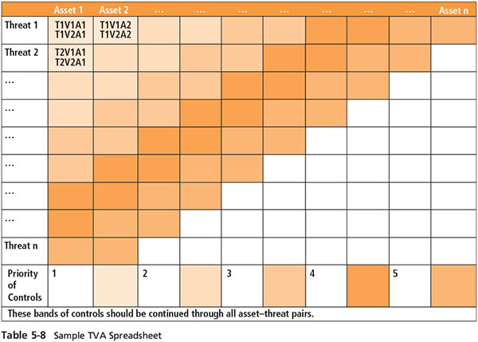
Table 5-8 Sample TVA Spreadsheet

Slide 34
Risk Assessment
Risk assessment evaluates the relative risk for each vulnerability.
It assigns a risk rating or score to each information asset.
Planning and organizing risk assessment
The goal at this point is to create a method for evaluating the relative risk of each listed vulnerability.
Notes:
Risk Assessment
Risk assessment evaluates the relative risk for each vulnerability
Assigns a risk rating or score to each information asset
Planning and organizing risk assessment
The goal at this point: create a method for evaluating the relative risk of each listed vulnerability

Slide 35
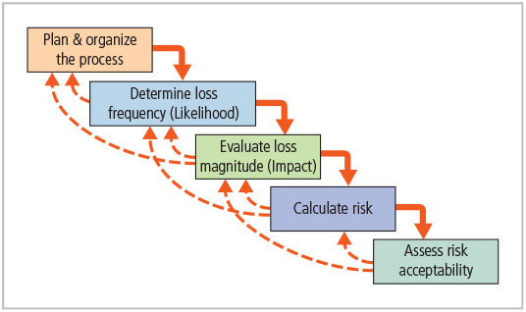
Figure 5-8 Major stages of risk assessment

Slide 36
Determining the Loss Frequency
It describes an assessment of the likelihood of an attack combined with expected probability of success.
Use external references for values that have been reviewed/adjusted for your circumstances.
Assign numeric value to likelihood, typically annual value.
Targeted by hackers once every five years
Annualized likelihook of attack: 1/5, 20 percent
Determining an attack’s success probability by estimating a quantitative value (e.g., 10 percent) for the likelihood of a successful attack; value subject to uncertainty.
Notes:
Determining the Loss Frequency
Describes assessment of likelihood of attack combined with expected probability of success
Use external references for values that have been reviewed/adjusted for your circumstances
Assign numeric value to likelihood, typically annual value
Targeted by hackers once every five years: 1/5, 20%
Determining attack success probability by estimating quantitative value (ex. 10%) for likelihood of successful attack; value subject to uncertainty

Slide 37
Evaluating Loss Magnitude
The next step is to determine how much of an information asset could be lost in a successful attack.
Also known as loss magnitude or asset exposure
Combines the value of information asset with the percentage of asset lost in the event of a successful attack.
Difficulties involve:
Valuating an information asset
Estimating the percentage of information asset lost during best-case, worst-case, and most likely scenarios
Notes:
Evaluating Loss Magnitude
Next step is to determine how much of an information asset could be lost in successful attack
Also known as loss magnitude or asset exposure
Combines value of information asset with percentage of asset lost in event of successful attack
Difficulties involve:
Valuating an information asset
Estimating percentage of information asset lost during best-case, worst-case, and most likely scenarios

Slide 38
Calculating Risk
For the purpose of relative risk assessment, risk equals:
Loss frequency TIMES loss magnitude
MINUS the percentage of risk mitigated by current controls
PLUS an element of uncertainty
Notes:
Risk Determination
For the purpose of relative risk assessment, risk equals:
Loss frequency TIMES loss magnitude
MINUS percentage of risk mitigated by current controls
PLUS an element of uncertainty

Slide 39
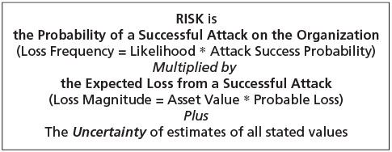
Figure 5-9 Factors of risk

Slide 40
Risk ratings
Information asset A indicates a 10% chance of attack based on a 10 year estimate. The attack has a 50% chance of success based on current asset vulnerabilities and protection mechanism. The asset is valued at a score of 50 on a scale of 0 to100. The staff expect that 100% of the asset would be lost on an attack. You estimate the assumptions and data are 90% accurate.
Information asset B has a 1% chance of attack. The attack has 10% chance of success based on current asset vulnerabilities and protection mechanism. The asset is valued at a score of 25 on a scale of 0 to100. The staff expect that 50% of the asset would be lost on an attack. You estimate the assumptions and data are 90% accurate. is:
Asset A’ risk is (10%* 50%)*(50*100%) +10% which is (5%* 50)+10%=
2,5+10%=2,75
Asset B:(1%*10%)*(25*50%) +10% which is (0,1%* 12,5)+10% =
0,125+10%=0,1375

Slide 41
Assessing Risk Acceptability
For each threat and associated vulnerabilities that have residual risk, create ranking of relative risk levels.
Residual risk is the left-over risk after the organization has done everything feasible to protect its assets.
If risk appetite is less than the residual risk, it must look for additional strategies to further reduce the risk.
If risk appetite is greater than the residual risk, it must proceed to the latter stages of risk control.
Notes:
Identify Possible Controls
For each threat and associated vulnerabilities that have residual risk, create ranking of relative risk levels
Residual risk is left-over risk after organization has done everything feasible to protect assets
If risk appetite less than residual risk, must look for additional strategies to further reduce the risk
If appetite greater than residual risk, proceed to latter stages of risk control

Slide 42
Documenting the Results of Risk Assessment
The final summarized document is the ranked vulnerability risk worksheet.
Worksheet describes asset, asset relative value, vulnerability, loss frequency, and loss magnitude.
Ranked vulnerability risk worksheet is the initial working document for the next step in the risk management process: assessing and controlling risk.
Notes:
Documenting Results of Risk Assessment
The goal of this process has been to identify the information assets of the organization that have specific vulnerabilities and create a list of them, ranked for focus on those most needing protection first.
In preparing this list, we have collected and preserved a wealth of factual information about the assets, the threats they face, and the vulnerabilities they experience.
We should also have collected some information about the controls that are already in place.

Slide 43
Table 5-9 Ranked vulnerability risk worksheet
Asset | Asset relative value | vulnerability | Loss frequency | Loss magnitude
Customer service request via e-mail (inbound) | 55 | E-mail disruption due to hardware failure | 0.2 | 11
Customer order via SSL (inbound) | 100 | Lost orders due to web server hardware failure | 0.1 | 10
Customer order via SSL (inbound) | 100 | Lost orders due to web server or ISP service failure | 0.1 | 10
Customer service request via e-mail (inbound) | 55 | E-mail disruption due to SMTP mail relay attack | 0.1 | 5.5
Customer service request via e-mail (inbound) | 55 | E-mail disruption due to ISP service failure | 0.1 | 5.5
Customer order via SSL (inbound) | 100 | Lost orders due to web server denial-of-service attack | 0.025 | 2.5
Customer order via SSL (inbound) | 100 | Lost orders due to web server software failure | 0.01 | 1

Slide 44
Table 5-10 Risk identification and Assessment Deliverables
Deliverable | Purpose
Information asset classification worksheet | Assembles information about information assets and their value to the organization
Weighted criteria analysis worksheet | Assigns a ranked value or impact weight to each information asset
Ranked vulnerability risk worksheet | Assigns a ranked value or risk rating for each uncontrolled asset-vulnerability pair

Slide 45
The Open FAIR Approach to Risk Assessment
Identify scenario components
Evaluate loss event frequency
Evaluate probable loss magnitude
Derive and articulate risk

Slide 46
Risk Control
Involves selection of control strategies, justification of strategies to upper management, and implementation/monitoring/on going assessment of adopted controls
Once the ranked vulnerability risk worksheet is complete, the organization must choose one of five strategies to control each risk:
Defense
Transference
Mitigation
Acceptance
Termination
Notes:
Risk Control Strategies
Involves selection of control strategies, justification of strategies to upper management, and implementation/monitoring/ongoing assessment of adopted controls
Once ranked vulnerability risk worksheet complete, must choose one of five strategies to control each risk:
Defense
Transfer
Mitigation
Acceptance
Termination

Slide 47
Defense
Attempts to prevent exploitation of the vulnerability
Preferred approach
Accomplished through countering threats, removing asset vulnerabilities, limiting asset access, and adding protective safeguards
Three common methods of risk avoidance:
Application of policy
Education and training
Applying technology
Notes:
Attempts to prevent exploitation of the vulnerability
Preferred approach
Accomplished through countering threats, removing asset vulnerabilities, limiting asset access, and adding protective safeguards
Three common methods of risk avoidance:
Application of policy
Education and training
Applying technology

Slide 48
Transference
This strategy attempts to shift risk to other assets, processes, or organizations.
If lacking, the organization should hire individuals/firms that provide security management and administration expertise.
The organization may then transfer the risk associated with management of complex systems to another organization experienced in dealing with those risks.

Slide 49
Mitigation
Attempts to reduce the impact of an attack rather than reduce the success of the attack itself
Approach includes three types of plans:
Incident response (IR) plan: define the actions to take while incident is in progress
Disaster recovery (DR) plan: the most common mitigation procedure; preparations for the recovery process
Business continuity (BC) plan: encompasses the continuation of business activities if a catastrophic event occurs
Notes:
Mitigation
Attempts to reduce impact of attack rather than reduce success of attack itself
Approach includes three types of plans
Incident response (IR) plan: define the actions to take while incident is in progress
Disaster recovery (DR) plan: most common mitigation procedure; preparations for recovery process
Business continuity (BC) plan: encompasses continuation of business activities if catastrophic event occurs

Slide 50
Acceptance and Termination
Acceptance
Doing nothing to protect a vulnerability and accepting the outcome of its exploitation
Valid only when the particular function, service, information, or asset does not justify the cost of protection
Termination
Directs the organization to avoid business activities that introduce uncontrollable risks
May seek an alternate mechanism to meet the customer needs
Notes:
Acceptance and Termination
Acceptance
Doing nothing to protect a vulnerability and accepting the outcome of its exploitation
Valid only when the particular function, service, information, or asset does not justify cost of protection
Termination
Directs the organization to avoid business activities that introduce uncontrollable risks
May seek an alternate mechanism to meet customer needs

Slide 51
Table 5-17 summary of risk control strategies
Risk control strategy | Categories used by NIST SP 800-30, Rev. 1 | Categories used by ISACA and ISO/IEC 27001 | Others
Defense | Research and acknowledgement | Treat | Self-protection
Transference | Risk transference | Transfer | Risk transfer
Mitigation | Risk limitation and risk planning | Tolerate (partial) | Self-insurance (partial)
Acceptance | Risk assumption | Tolerate (partial) | Self-insurance (partial)
Termination | Risk avoidance | Terminate | Avoidance

Slide 52
Selecting a Risk Control Strategy
Level of threat and value of asset should play a major role in the selection of strategy.
Rules of thumb on strategy selection can be applied:
When a vulnerability exists
When a vulnerability can be exploited
When attacker’s cost is less than the potential gain
When potential loss is substantial
Notes:
Mitigation Strategy Selection
Level of threat and value of asset should play major role in selection of strategy
Rules of thumb on strategy selection can be applied:
When a vulnerability exists
When a vulnerability can be exploited
When attacker’s cost is less than potential gain
When potential loss is substantial

Slide 53
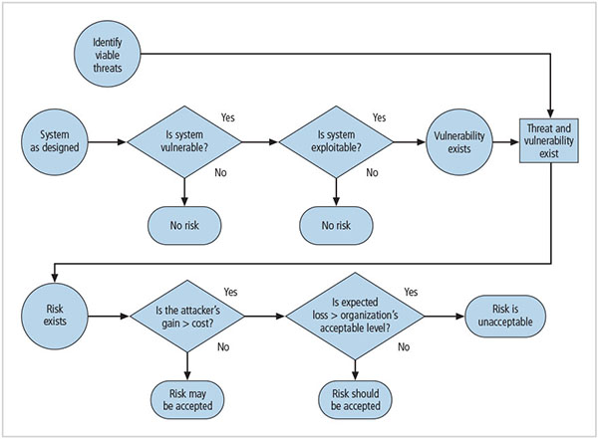
Figure 5-12 Risk handling decision points

Slide 54
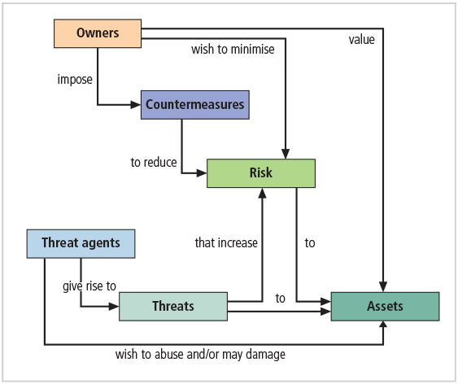
Figure 5-13 Relationship of risk to threats, assets, and countermeasures

Slide 55
Justifying Controls (1 of 2)
Before implementing one of the control strategies for a specific vulnerability, the organization must explore all consequences of vulnerability to information asset.
There are several ways to determine the advantages/disadvantages of a specific control.
Items that affect cost of a control or safeguard include cost of development or acquisition, training fees, implementation cost, service costs, and cost of maintenance.
Notes:
Justifying Controls
Before implementing one of the control strategies for a specific vulnerability, organization must explore all consequences of vulnerability to information asset
Several ways to determine advantages/disadvantages of a specific control
Items that affect cost of a control or safeguard include: cost of development or acquisition; training fees; implementation cost; service costs; cost of maintenance

Slide 56
Justifying Controls (2 of 2)
Asset valuation involves estimating real/perceived costs associated with design, development, installation, maintenance, protection, recovery, and defense against loss/litigation.
Process result is the estimate of potential loss per risk.
Expected loss per risk stated in the following equation:
Annualized loss expectancy (ALE) = single loss expectancy (SLE) × annualized rate of occurrence (ARO)‏
SLE = asset value × exposure factor (EF)‏
Notes:
Justifying Controls
Asset valuation involves estimating real/perceived costs associated with design, development, installation, maintenance, protection, recovery, and defense against loss/litigation
Process result is estimate of potential loss per risk
Expected loss per risk stated in the following equation:
Annualized loss expectancy (ALE) = single loss expectancy (SLE) × annualized rate of occurrence (ARO)‏
SLE = asset value × exposure factor (EF)‏

Slide 57
The Cost-Benefit Analysis (CBA) Formula
CBA determines if an alternative being evaluated is worth the cost incurred to control vulnerability.
The CBA is most easily calculated using the ALE from earlier assessments, before implementation of the proposed control:
CBA = ALE(prior) – ALE(post) – ACS
ALE(prior) is the annualized loss expectancy of risk before implementation of control.
ALE(post) is the estimated ALE based on control being in place for a period of time.
ACS is the annualized cost of the safeguard.
Notes:
CBA: Formula
CBA determines if alternative being evaluated is worth cost incurred to control vulnerability
CBA most easily calculated using ALE from earlier assessments, before implementation of proposed control:
CBA = ALE(prior) – ALE(post) – ACS
ALE(prior) is annualized loss expectancy of risk before implementation of control
ALE(post) is estimated ALE based on control being in place for a period of time
ACS is the annualized cost of the safeguard

Slide 58
Implementation, Monitoring, and Assessment of Risk Controls
The selection of the control strategy is not the end of a process.
Strategy and accompanying controls must be implemented and monitored on on going basis to determine effectiveness and accurately calculate the estimated residual risk.
Process continues as long as the organization continues to function.
Notes:
Implementation, Monitoring, and Assessment of Risk Controls
Selection of control strategy is not end of process
Strategy and accompanying controls must be implemented and monitored on ongoing basis to determine effectiveness and accurately calculate the estimated residual risk
Process continues as long as organization continues to function

Slide 59
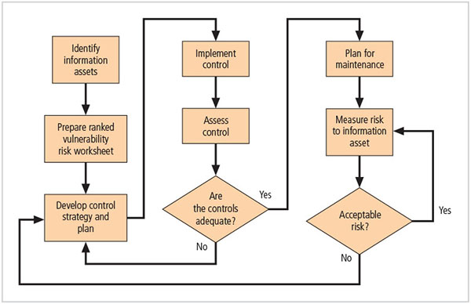
Figure 5-14 Risk control cycle

Slide 60
Quantitative Versus Qualitative Risk Control Practices
Performing the previous steps using actual values or estimates is known as quantitative assessment.
Possible to complete steps using an evaluation process based on characteristics using nonnumerical measures, called qualitative assessment.
Utilizing scales rather than specific estimates relieves the organization from the difficulty of determining exact values.
Notes:
Quantitative versus Qualitative Risk Control Practices
Performing the previous steps using actual values or estimates is known as quantitative assessment
Possible to complete steps using evaluation process based on characteristics using nonnumerical measures; called qualitative assessment
Utilizing scales rather than specific estimates relieves organization from difficulty of determining exact values

Slide 61
Benchmarking and Best Practices (1 of 5)
An alternative approach to risk management
Benchmarking: process of seeking out and studying practices in other organizations that one’s own organization desires to duplicate
One of two measures typically used to compare practices:
Metrics-based measures, based on numerical standards
Process-based measures, more strategic and less focused on numbers
Notes:
Benchmarking and Best Practices
An alternative approach to risk management
Benchmarking: process of seeking out and studying practices in other organizations that one’s own organization desires to duplicate
One of two measures typically used to compare practices:
Metrics-based measures; based on numerical standards
Process-based measures; more strategic and less focused on numbers

Slide 62
Benchmarking and Best Practices (2 of 5)
Standard of due care: when adopting levels of security for a legal defense, the organization shows it has done what any prudent organization would do in similar circumstances.
The application of controls at or above prescribed levels and the maintenance of standards of due care show due diligence on the organization’s part.
Failure to support standard of due care or due diligence can leave the organization open to legal liability.
Notes:
Benchmarking/Best Practices cont’d.
Standard of due care: when adopting levels of security for a legal defense, organization shows it has done what any prudent organization would do in similar circumstances
Application of controls at or above prescribed levels and maintenance of standards of due care show due diligence on organization’s part
Failure to support standard of due care or due diligence can leave organization open to legal liability

Slide 63
Benchmarking and Best Practices (3 of 5)
Best business practices: security efforts that provide a superior level of information protection
When considering best practices for adoption in an organization, consider:
Does organization resemble identified target organization with best practice?
Are expendable resources similar?
Is organization in a similar threat environment?
Notes:
Best Business Practices
Best business practices: security efforts that provide a superior level of information protection
When considering best practices for adoption in an organization, consider:
Does organization resemble identified target organization with best practice?
Are expendable resources similar?
Is organization in a similar threat environment?

Slide 64
Benchmarking and Best Practices (4 of 5)
Problems with the application of benchmarking and best practices
Organizations don’t talk to each other (biggest problem)‏.
No two organizations are identical.
Best practices are a moving target.
Researching information security benchmarks doesn’t necessarily prepare a practitioner for what to do next.
Notes:
Problems with Benchmarking and Best Practices
Problems with the application of benchmarking and best practices
Organizations don’t talk to each other (biggest problem)‏
No two organizations are identical
Best practices are a moving target
Researching information security benchmarks doesn’t necessarily prepare practitioner for what to do next

Slide 65
Benchmarking and Best Practices (5 of 5)
Baselining
Performance value or metric used to compare changes in the object being measured.
In information security, baselining is the comparison of past security activities and events against an organization’s future performance.
Useful during baselining to have a guide to the overall process.
Notes:
Baselining
Baselining
Performance value or metric used to compare changes in object being measured
In information security, baselining is comparison of past security activities and events against an organization’s future performance
Useful during baselining to have a guide to the overall process

Slide 66
Other Feasibility Studies
Organizational: Assesses how well the proposed IS alternatives will contribute to an organization’s efficiency, effectiveness, and overall operation
Operational: Assesses user and management acceptance and support, and the overall requirements of the organization’s stakeholders
Technical: Assesses if organization has or can acquire the technology necessary to implement and support proposed control
Political: Defines what can/cannot occur based on the consensus and relationships among communities of interest
Notes:
Organizational Feasibility
Organizational: assesses how well proposed IS alternatives will contribute to organization’s efficiency, effectiveness, and overall operation
Operational: assesses user and management acceptance and support, and the overall requirements of the organization’s stakeholders
Technical: assesses if organization has or can acquire the technology necessary to implement and support proposed control
Political: defines what can/cannot occur based on consensus and relationships among communities of interest

Slide 67
Recommended Risk Control Practices
Convince budget authorities to spend up to the value of an asset to protect it from identified threat.
Chosen controls may be a balanced mixture that provides greatest value to as many asset-threat pairs as possible.
Organizations looking to implement controls that don’t involve such complex, inexact, and dynamic calculations.
Notes:
Recommended Practices in Controlling Risk
Convince budget authorities to spend up to value of asset to protect from identified threat
Chosen controls may be a balanced mixture that provides greatest value to as many asset-threat pairs as possible
Organizations looking to implement controls that don’t involve such complex, inexact, and dynamic calculations

Slide 68
Documenting Results
At minimum, each information asset-threat pair should have documented control strategy clearly identifying any remaining residual risk.
Another option: Document the outcome of the control strategy for each information asset-vulnerability pair as an action plan.
Risk assessment may be documented in a topic-specific report.
Notes:
Documenting Results
At minimum, each information asset-threat pair should have documented control strategy clearly identifying any remaining residual risk
Another option: document outcome of control strategy for each information asset-vulnerability pair as an action plan
Risk assessment may be documented in a topic-specific report

Slide 69
The NIST Risk Management Framework
Describes risk management as a comprehensive process requiring organizations to:
Frame risk
Assess risk
Respond to determined risk
Monitor risk on on going basis
Notes:
NIST Risk Management Framework
Describes risk management as comprehensive process requiring organizations to
Frame risk
Assess risk
Respond to determined risk
Monitor risk on ongoing basis

Slide 70
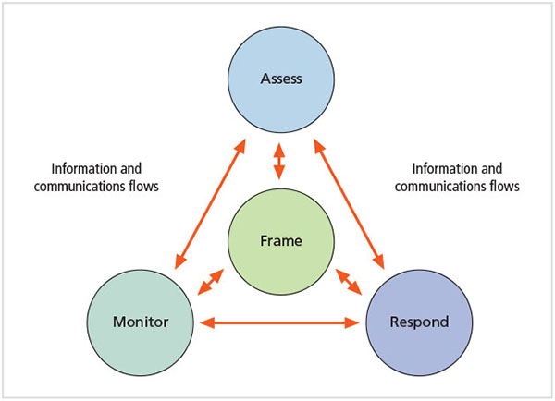
Figure 5-15 NIST risk management process

Slide 71
Summary (1 of 3)
Risk identification: formal process of examining and documenting risk in information systems
Risk control: process of taking carefully reasoned steps to ensure the confidentiality, integrity, and availability of the components of an information system
Risk identification
A risk management strategy enables identification, classification, and prioritization of organization’s information assets
Residual risk: risk remaining to the information asset even after the existing control is applied
Notes:
Summary
Risk identification: formal process of examining and documenting risk in information systems
Risk control: process of taking carefully reasoned steps to ensure the confidentiality, integrity, and availability of components of an information system
Risk identification
A risk management strategy enables identification, classification, and prioritization of organization’s information assets
Residual risk: risk remaining to the information asset even after the existing control is applied

Slide 72
Summary (2 of 3)
Risk control: Five strategies are used to control risks that result from vulnerabilities:
Defend
Transference
Mitigate
Accept
Terminate
The economic feasibility study determines the costs associated with protecting an asset. The formal documentation process of feasibility is called a cost-benefit analysis.
Notes:
Summary
Risk control: five strategies are used to control risks that result from vulnerabilities:
Defend
Transfer
Mitigate
Accept
Terminate

Slide 73
Summary (3 of 3)
The economic feasibility study determines the costs associated with protecting an asset. The formal documentation process of feasibility is called a cost-benefit analysis.
Benchmarking is an alternative method to economic feasibility analysis that seeks out and studies practices used in other organizations to produce desired results in one’s own organization.

